Slide 1
Solving Business Problems Using AI and ML
Identify AI and ML Solutions for Business Problems
Follow a Machine Learning Workflow
Formulate a Machine Learning Problem
Select Appropriate Tools

Slide 2

Identify AI and ML Solutions for Business Problems

Slide 3

The Data Hierarchy
Knowledge
Information
Data

Slide 4

Big Data
Volume
Petabytes
Terabytes
Gigabytes
Megabytes
Kilobytes
Variety
Unstructured data
Audio, video
Images
Structured tables
Simple data values
Velocity
Batch
Periodic
Near real time
Real time
Big Data

Slide 5

Handle Large Datasets in Machine Learning
Work with less data when possible.
Use a more efficient data format.
Don't load all data at one time.
Reconfigure your system memory.
Use a different system with more memory and processing power.
Big Data

Slide 6

Data Mining
Transforms big data into actionable intelligence
Also called knowledge discovery
Uses statistical analysis methods to find meaningful patterns in data that reveal such things as:
Clusters—Groupings of similar records that belong together
Dependencies—Records that depend on each other for related information
Anomalies—Records that don't seem to belong, don't follow expected patterns
Can be automated to some extent, leveraging the power of computers
Big Data

Slide 7

Examples of Applied AI and ML in Business
Inform business decisions
Improve the Utilization of Staff and Equipment
Improve Sales and Customer Experience
Automated Inspection
Finance
Security
Identification or Classification Tasks
Process Guidance and Navigation
Visual Interaction

Slide 8

Identify Business Problems that Are Appropriate for AI/ML
You currently have sufficient data or can obtain it.
The problem is sufficiently self-contained or isolated from outside influence.
It is acceptable for the machine to provide an answer without your being completely clear how it got that answer.
It is acceptable if the solution is not always 100% right.
It is a learning problem, rather than just an automation problem.

Slide 9
Identify Challenges of AI and ML in Business
Collecting and storing essential data
Changing data landscape
Making informed decisions related to implementation costs
Using data legally and ethically
Selecting and implementing technology
Identifying staff with specialized skills

Slide 10
Activity: Identifying Appropriate Business Applications for AI and ML
You have found a dataset to use for your machine learning project, but someone on the project team doesn't think it would work well as the basis for a machine learning project. What might lead her to such a conclusion from looking at the data?
You find another source of data that you could use for the project. It includes a historic database of more than three million transactions. Some of the specific data you need are not present, but it might be possible to infer what you need from the data that exists. Furthermore, some columns of data are missing as many as 5% of their data values. In this case, the statistician does not seem to think that the incomplete data is a problem, and she thinks that the dataset will actually work quite well for machine learning. Why is this situation acceptable for a machine learning project?
You're working with a major online clothing retailer to enhance their online Search feature, which customers use to find articles of clothing they want to buy. What types of improvements might be added to the Search feature through machine learning technology?

Slide 11
Follow a Machine Learning Workflow

Slide 12
Machine Learning Model
Model: A mathematical representation of a process or system that you need to analyze or automate in some way.
What the Model Represents | How the Model Might be Applied
Attributes that influence how a person might react to a particular medical treatment | A system that helps doctors select an appropriate course of treatment
Attributes that influence product sales | A system that recommends appropriate product pricing that will help to meet sales objectives
Attributes that influence the overall health and growth of plants | A system that monitors crops and guides the application of fertilizer, soil amendments, irrigation, and so forth

Slide 13

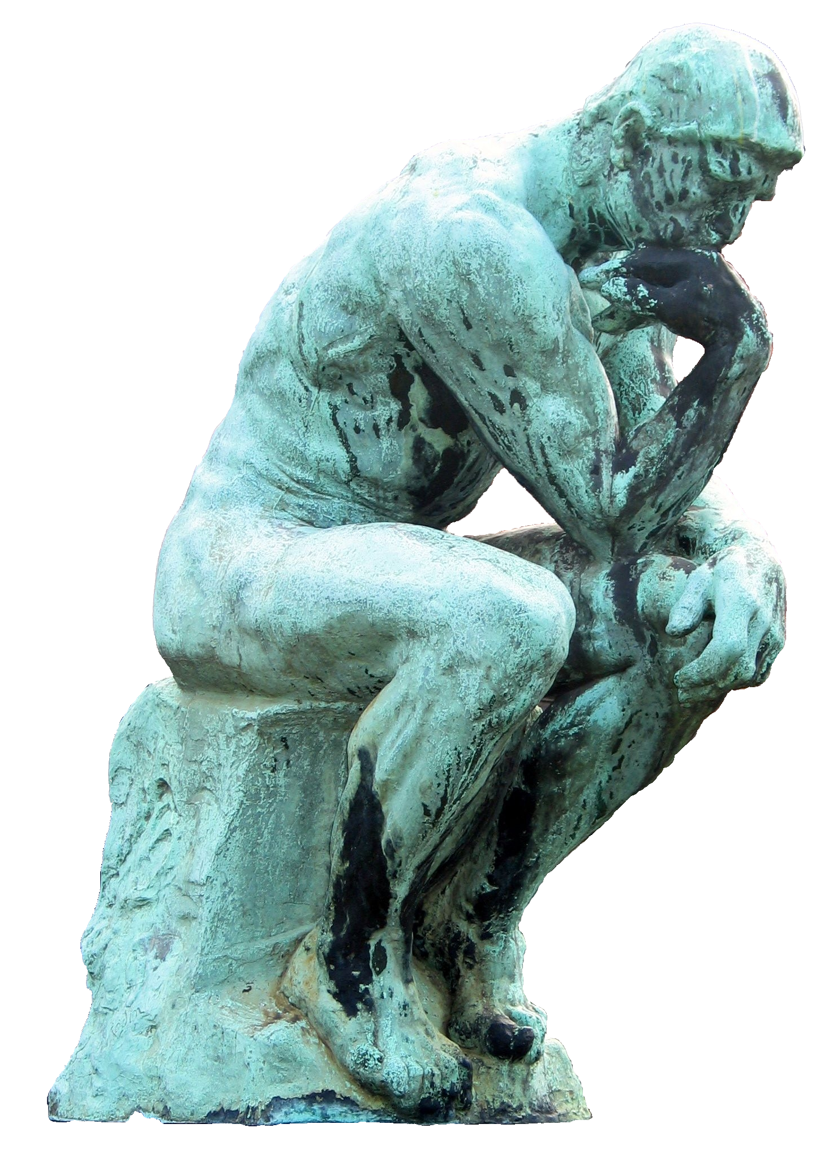





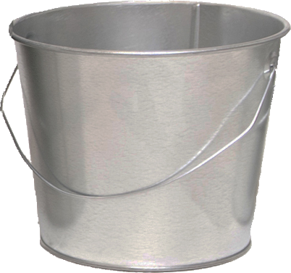
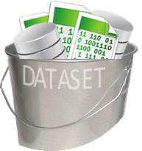







Machine Learning Workflow
Formulate the problem
DATASET ,
Collect the dataset
Understand the dataset
DATASET ,
TUNING
Clean the data and engineer features
PRECISION
RECALL
RESULTS
Select, train, and tune the model
Apply the model and present the results

Slide 14
Data Science Skillset
AI/ML projects
Are different from traditional IT or software development projects.
Are very dependent on the quantity, quality, and type of data.
May be driven by speculation that clues hidden within existing data may help to solve a problem or improve business performance in some way.
May require exploration and research to answer questions such as:
What data is available?
How does the data relate to the problems the organization wants to solve?
What ML or AI method might be most appropriate to use?
How should success be measured?
Upon answering these questions you might either:
Determine that a more traditional approach is more efficient or cost-effective than AI/ML.
Confirm the benefits of using AI/ML on the project.
Work in the exploration and research stage requires one to operate like a researcher or data scientist.

Slide 15
Traditional IT Skillsets
Once the research phase is done and you must develop the solution:
The work may become more like a traditional IT or software development project.
It becomes necessary to answer questions such as:
Should a data pipeline be constructed to support the model, and if it should, then how?
How should the solution be developed and deployed to perform adequately at scale and allow for growth and future improvements?
How should the system be maintained to keep it running optimally?
In many organizations, the lines between traditional job roles have blurred.
DevOps—combining development and operations responsibilities
Software developers who also happen to be skilled data scientists
Important to recognize the shift in skillsets at different points in an AI/ML project, and make sure that people with the right skillsets are involved at the right time.
Some problems may require hardware you don't have:
GPUs
Computer clusters
Cloud services
These systems require additional skillsets in the organization.

Slide 16

Concept Drift
Machine learning models:
Are trained on historical data so the finished model can make predictions about the future.
May become less effective over time due to concept drift.
Should be considered when planning how models will be maintained in projects where a machine learning model is integrated into a long-term software solution.
Concept Drift: Statistical properties of the target variable that the model is trying to predict change over time, resulting in less effective predictions.

Slide 17
Transfer Learning
After you devote extensive time and resources to develop and refine models:
You may have to develop a new model to solve a similar problem.
You may have to update an old model, perhaps because of concept drift.
Transfer learning:
Enables you to build on the previous model, rather than starting over from scratch.
Can speed up the training process and improve the performance of your new model.

Slide 18
Follow the Machine Learning Workflow
Formulate the problem
Collect the dataset
Understand the dataset
Clean and prepare the data
Select, train, and tune the model
Apply the model and present the results

Slide 19
Activity: Planning the Machine Learning Workflow
Challenges of the job
Challenge One—How to express a business problem as an ML problem.
It may not always be clear how business problems translate into an AI/ML problem.
Customers may express problems in vague, general terms.
Challenge Two—Finding the right data.
You may not have enough data (or the right data) to solve the problem.
Brainstorming these problems with stakeholders, experts, and consultants is often a good place to start.
Questions:
How might you translate a statement like "We need to reduce our cost to manufacture Product X" into a problem that you can solve through AI/ML?
You have identified a business problem that you want to solve, but upon collecting and examining the data that is available to you, you think you may not have the data needed to solve the problem. How should you proceed?

Slide 20
Formulate a Machine Learning Problem

Slide 21


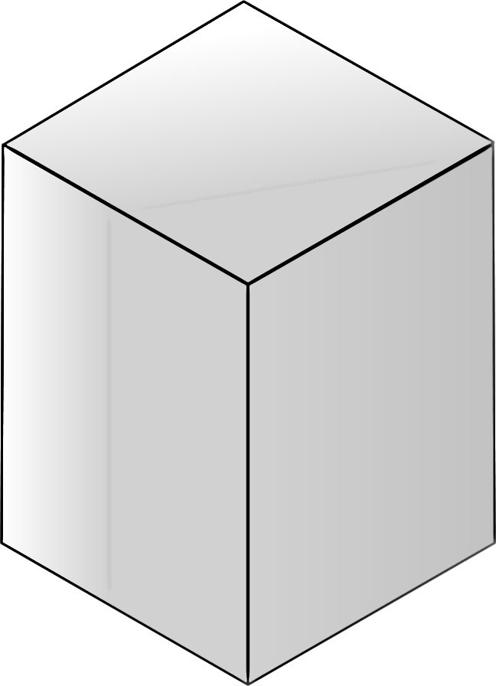

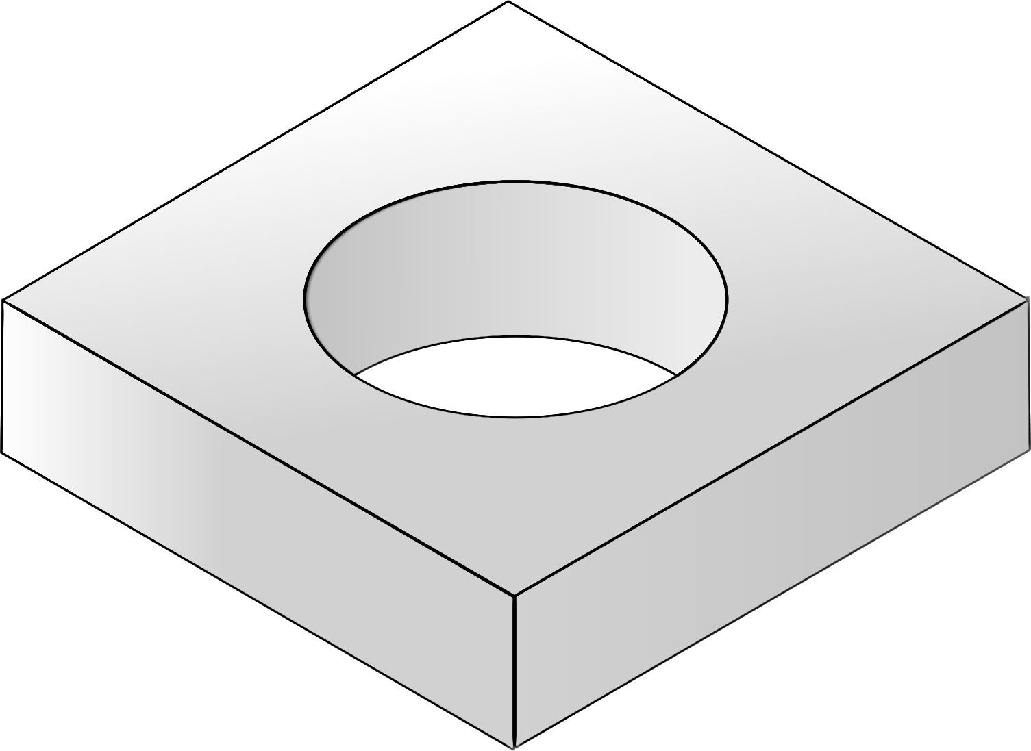
Problem Formulation
Task Experience Performance
why?
Frame the problem.
Background Info
Identify why the problem must be solved.
Provide background information that will help to solve the problem.
Determine whether the
problem is appropriate
for AI/ML.

Slide 22
Activity: Framing a Machine Learning Problem - 1
Business requirement: CapitalR Real Estate company has contracted with you to develop a tool that agents can use to price homes appropriately.
Machine learning problem: Determine the price at which a house will sell.
If overpriced:
Might remain on the market for a long time
May go “stagnant,” ignored by customers even if price is dropped later
May eventually sell for a lower price than it would have if initial price had been more reasonable
If underpriced:
Might sell quickly
Owner (and the salesperson, paid on percentage of sale price) may suspect they could have gotten more for the home had they priced it higher
There are significant incentives to find the "right" price for a house.
Complications
The market fluctuates based on variables such as the local economy, time of year, public perceptions, and numerous other factors that change over time.
Some customers may require a quick sale, while others are content to wait a long time for a buyer, if it means getting a better price for the home.

Slide 23
Activity: Framing a Machine Learning Problem - 2
You are considering whether machine learning might provide a good solution.
Questions:
What sort of task should the model perform?
What sort of experience (training dataset) would you need to provide so the model could learn how to price a home?
Once you've created a prototype machine learning model, how might you evaluate the model's performance (that is, its ability to identify an optimum sales price)?
Over time, after the real estate company has started using the tool, how might you evaluate whether the new tool has benefited the business?
Is a machine learning solution appropriate for this problem?

Slide 24





Traditional Programming vs. Machine Learning
Traditional Programming
Machine Learning
A
Analyze the problem
1
Analyze the problem
B
2
T
Produce/revise the sample dataset
Select algorithm and prepare datasets
E
C
Write code
3
T
Algorithm uses training dataset to learn
Learning
D
Evaluate the output
4
E
Apply model to evaluation dataset
E
Revisions needed?
Yes
5
Revisions needed?
Yes
No
No
F
Deploy
6
Deploy

Slide 25

Differences Between Supervised and Unsupervised Learning
Machine learning may be supervised or unsupervised.
Unsupervised
No labels provided
Typical goals:
Reveal patterns or organization within the data
Organize related or similar items into clusters
Reveal underlying patterns or structure within the data
Independent learning
Supervised
The cow jumped over the moon.
Labels provided
Typical goals:
Predict an outcome based on an item’s features
Place an item into the correct category based on its features
S
V
Learning under guidance

Slide 26
Randomness in Machine Learning
Machine learning:
Is based on mathematical fields that analyze randomness.
Statistics analyzes randomness within past events
Probability builds upon patterns identified by statistics to predict future events
Has randomness in data.
Which data points are sampled
Order in which they are sampled
Samples that are selected for training and testing a model
Has randomness among machine learning algorithms.
May produce slightly different results simply because they follow different steps
May have different performance characteristics
May perform better on smaller or larger datasets
Uses stochastic models.
Individual data samples are inherently random and can't be perfectly predicted
Taken together, the entire set of data can be shown to follow a general pattern
General patterns in the entire set enable reasonably good predictions about individual samples

Slide 27

Uncertainty
Due to randomness inherent in machine learning
Must be managed to produce good models
To reduce uncertainty in machine learning models:
Use probability to your advantage
Use more variety in data and algorithms
Make sure data is clean and correct to help make patterns in data more apparent
Employ strategies such as:
Running the same algorithm many times on several different samples
Running several different algorithms, testing the resulting models, and picking the one that produces the best results
Running several different algorithms, allowing each one to cast its "vote" for the answer, and taking the "wisdom of the crowd" as the answer
Selecting the right data (relevant to the problem)
Reducing noise (data values that are incorrect or misleading)

Slide 28
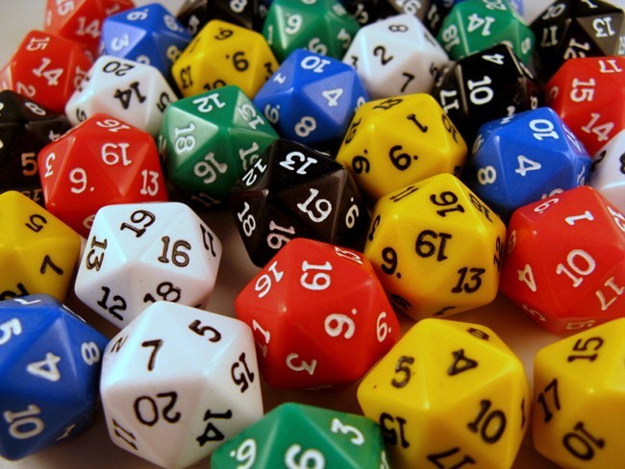
Random Number Generation
Random numbers generated by computers are not truly random.
Produced by deterministic math function
Seed values (e.g., based on current time) provide appearance of randomness.
Same seed value will produce the same result
Seeds therefore make random generators more deterministic
Such functions are called pseudorandom
Providing seed values is often done in machine learning.
Algorithm will produce same results for a seed each time it is run

Slide 29
Machine Learning Outcomes
Learning mode
Outcome
Use Case Examples
Regression
Weather forecasting
Market forecasting
Predicting life expectancy
y
Supervised
x
Classification
Identity fraud detection
Image classification
Diagnostics
+
+
x₁
+
+
+
x₂
Machine Learning
Unsupervised
Clustering
Recommender systems
Targeted marketing
Customer segmentation
x₁
x₂
Dimensionality Reduction
Big data visualization
Structure discovery
Feature elicitation
z
y
y
x
x
Reinforcement
Real-time decisions
Robot navigation
Learning tasks

Slide 30
Formulate a Machine Learning Problem
Describe the problem in plain language
Identify the ideal outcome
Define your success metrics
Define the ideal output
Identify where the data will come from
Determine when and how the inputs and output will be used
Identify ways the problem might be solved without ML
Formulate the problem as an ML problem

Slide 31

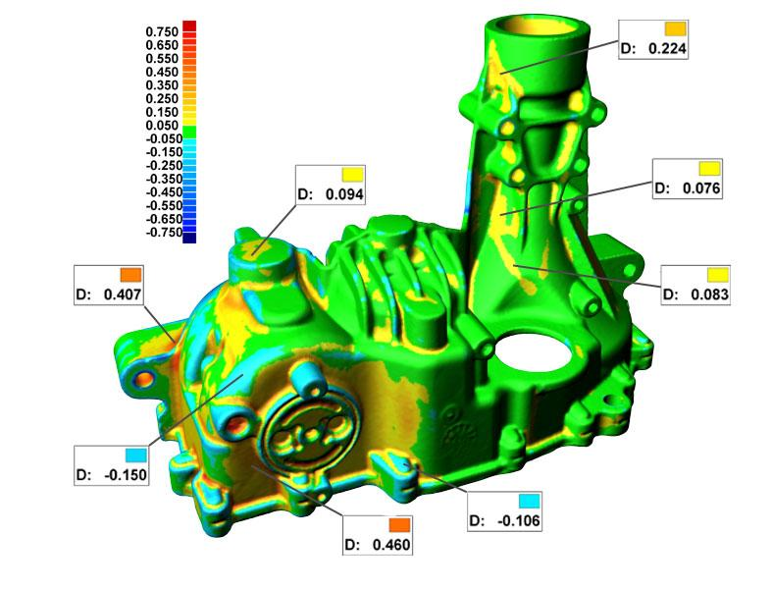
Activity – Selecting a Machine Learning Outcome
IOT Company
Global manufacturing company
Manufactures eco-friendly heating/cooling systems used in hotels, apartment buildings, retail stores, office buildings, and factories
Cast metal parts used in these systems are inspected by cameras to identify cracks, voids, other defects
IOT
COMPANY
Machine learning algorithms identify which parts are acceptable for use, and which parts are defective.
What type of outcome is this?
Regression
Classification
Clustering
Dimension Reduction

Slide 32
Select Appropriate Tools

Slide 33
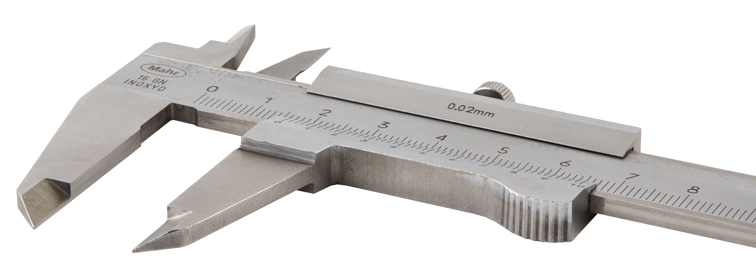
Open Source AI Tools
Programming Languages
Weka
NumPy
SciPy
pandas
Matplotlib
Seaborn
scikit-learn
NLTK
TensorFlow
PyTorch
Keras
Apache Spark MLlib
Jupyter Notebook
Google Colaboratory
Anaconda

Slide 34
Proprietary AI Tools
IBM Watson
AWS AI
Microsoft Azure AI
Google Cloud AI
MATLAB
Mathematica
Power BI

Slide 35
New Tools and Technologies
Constantly being added to the AI/ML toolbox
May be a two-edged sword
They provide additional tools to prepare datasets, solve problems, and present results. They may even make some tasks easier.
May add complexity to projects—particularly if you're not the only person working on a project.
To obtain consistent results and ensure that code will compile and run correctly, you must ensure that everyone on the team is using the same versions of software.
If one person uses functions from a particular software library, other team members need to ensure they have the same library installed on their development machine.

Slide 36
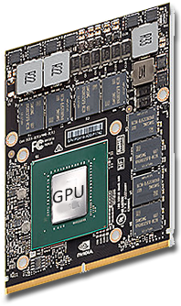
Hardware Requirements
Parallelization
Enables you to scale the performance of your machine learning environment
Divides up tasks among multiple processors
Involves setting up hardware with:
More processors and memory
The right software and configuration to support them
Using machine learning algorithms that can divide sub-tasks among multiple processors
Can significantly reduce the time needed to run a training algorithm
Makes it more practical to:
Experiment with multiple models
Retrain models on fresh data more frequently
Accurately fine-tune your models to attain higher performance in less time
Can be done to some extent by adding more processors to a single computer
When scaling by relatively small amounts, a single computer may be faster than using multiple computers since it avoids delays introduced by networking.
For massive scaling, multiple machines may be needed.

Slide 37
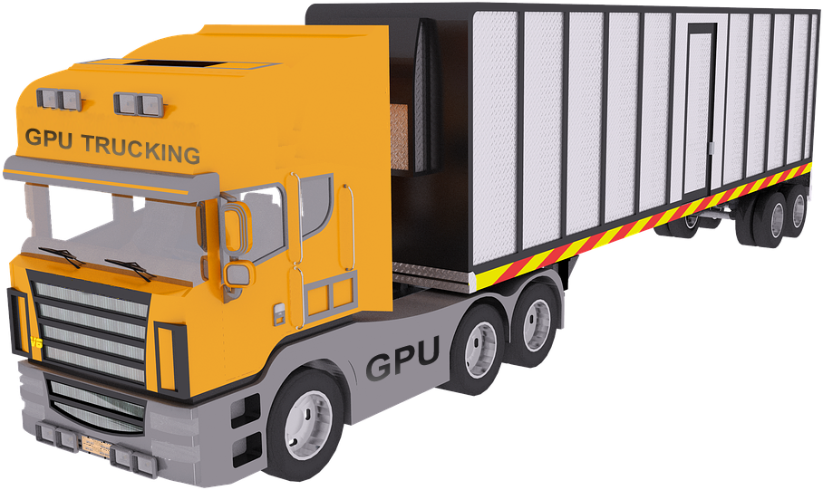

GPUs vs. CPUs
GPUs
Graphics processing units
Typically used as the core component in graphics adapters
Optimized for processing large amounts of memory at one time – suitable for:
Processing video
Deep learning matrix operations
CPUs
Central processing units
Typically used as the main processor in personal computers and servers
Optimized for processing small amounts of memory quickly

Slide 38
GPU Platforms
Not every GPU will work for a particular task.
GPUs must be specifically supported by the algorithms you are using.
Nvidia GPUs
Currently dominate deep learning
Supported through CUDA (Compute Unified Device Architecture):
Works with all Nvidia GPUs from the G8x series onwards, including GeForce, Quadro, and Tesla
Compatible with most standard operating systems
Provides good support across Nvidia's own GPUs
Does not support GPUs by other vendors (such as AMD)
AMD GPUs
Do not yet have the same support for deep learning as Nvidia
Supported through AMD’s new high performance computing platform, called ROCm (Radeon Open Compute platform):
Provides a common, open-source environment that can interface not only with AMD GPUs, but also Nvidia (through CUDA)
Unifies NVIDIA and AMD GPUs under a common programming language
Is not yet supported by many programming frameworks

Slide 39
Cloud Platforms
Such as Amazon AWS, Microsoft Azure, or Google TPU
Provide an alternative to purchasing GPU cards and setting up your own hardware
Virtual machine instances of GPUs
Enable you to easily scale up and scale down as needed
Can quickly rack up costs
GPUs running on your own local hardware
May be more cost-effective for small-scale experimentation, prototyping, and learning
Move your projects to cloud services only when you need to scale massively
Google Tensor Processing Unit (TPU)
May be more cost-efficient than virtual machine GPUs for some projects
Set of specialized GPUs that have been packaged together specifically to support fast matrix operations
A single cloud TPU is equivalent to 4 GPUs, with a significant speed benefit over GPUs and potentially lower cost
More customized product than raw GPUs, so may not be quite as versatile or flexible
When more flexibility is needed, use cloud-hosted GPUs instead

Slide 40
Assemble a Machine Learning Toolset
Tools in the machine learning stack
Platform
Core Machine Learning Capabilities
Libraries, Modules, or Plug-ins
Integrate Peripheral Tools
To save considerable time setting up and integrating a development environment, consider starting with a distribution such as Anaconda, which bundles many of these components.

Slide 41
Select a GPU Platform
For experimentation, prototyping, and learning:
Use a small number of local GPUs since the costs of cloud-based GPUs can add up quickly.
Straightforward matrix operations in the cloud:
For typical deep learning matrix operations in a supported frameworks such as TensorFlow, consider using TPUs to keep your costs down. Example tasks include training object recognition or transformer models.
Other matrix operations in the cloud:
Use cloud hosted GPUs like those offered by Amazon AWS or Microsoft Azure.

Slide 42
Activity: Selecting a Machine Learning Toolset
Options for your machine learning platform
Hosted
Set up software on your own computers
At some point you'll need to determine what software you intend to use
Questions
You need to load a data file in Python so you can manipulate the columns and rows of data it contains. Which of these tools would enable you to do this?
Which software library implements machine learning algorithms?
What capabilities does Anaconda provide for a machine learning project?
Explore online sites where you can download machine learning tools.

Slide 43
What sorts of business problems do you expect to solve using AI and machine learning solutions?
Have you already selected software tools that you intend to use in your machine learning stack? If so, what tools are you using?

